Slide 1
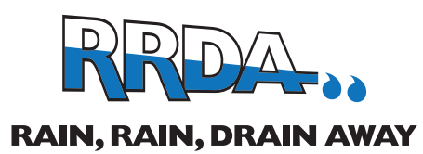
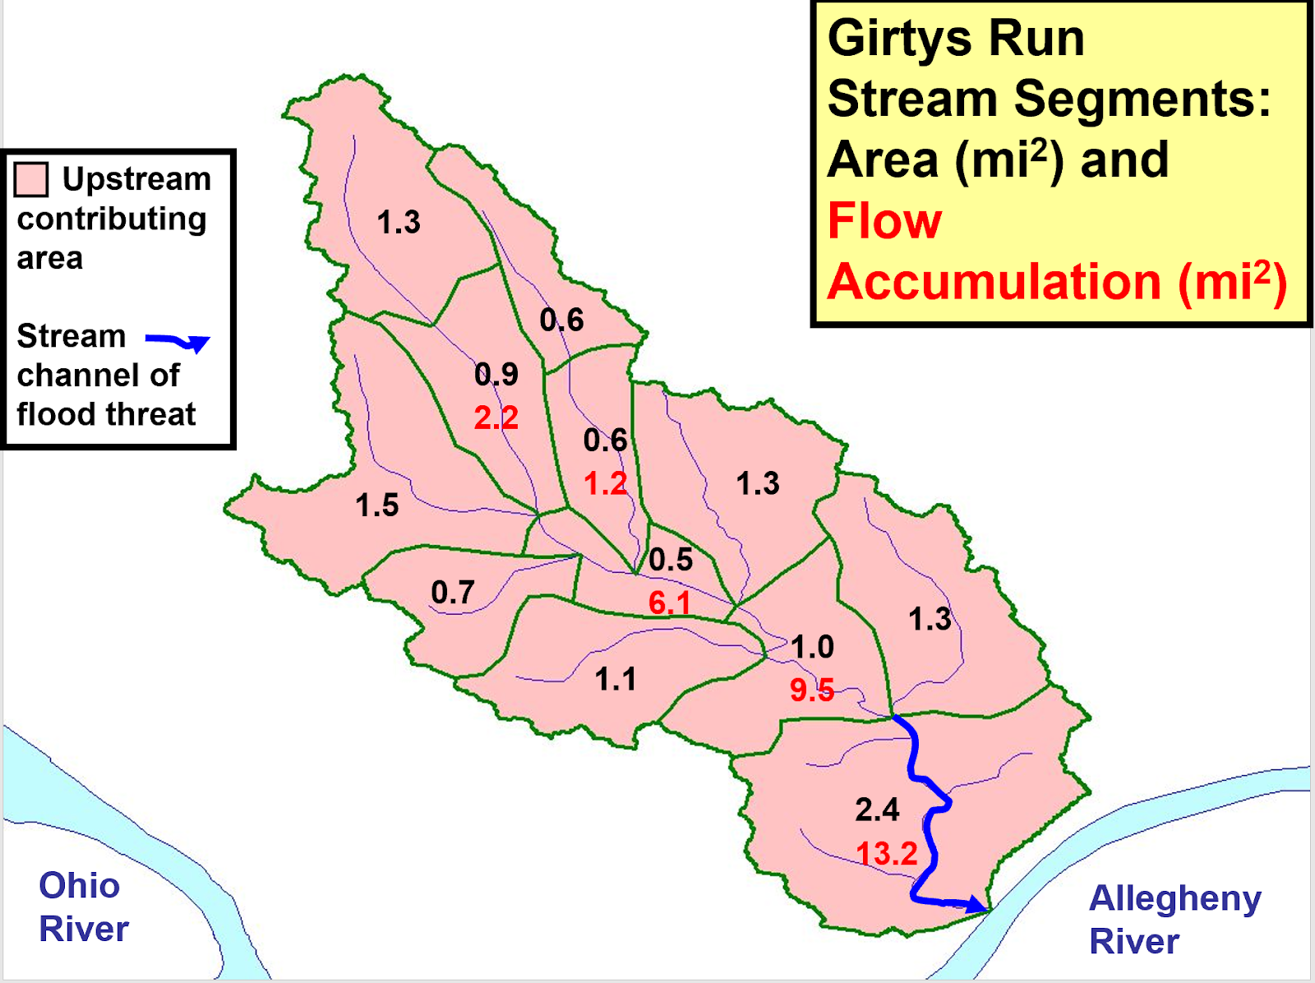
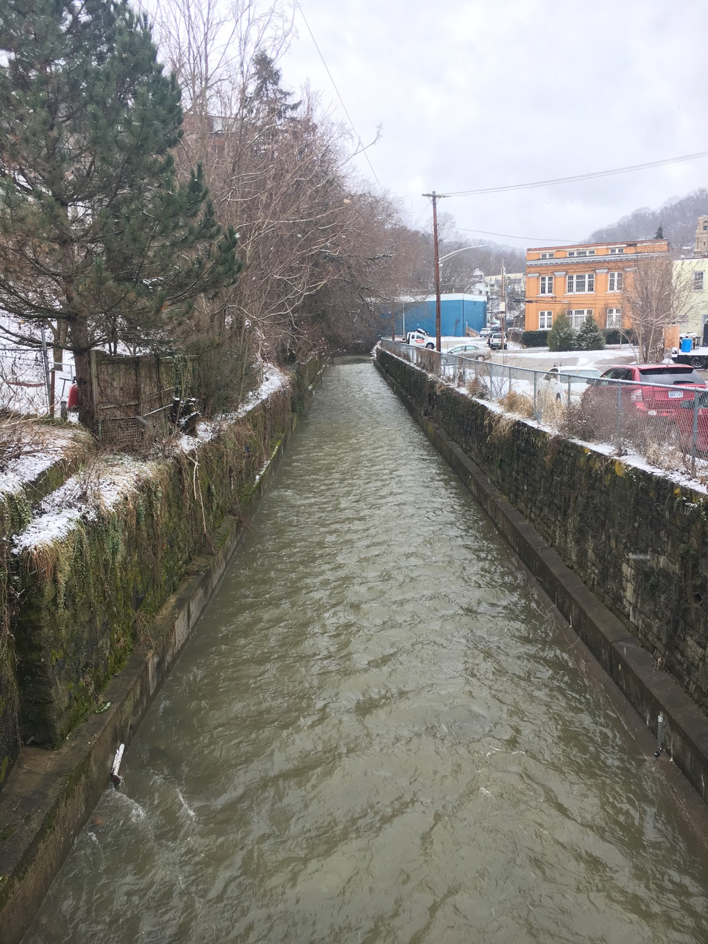
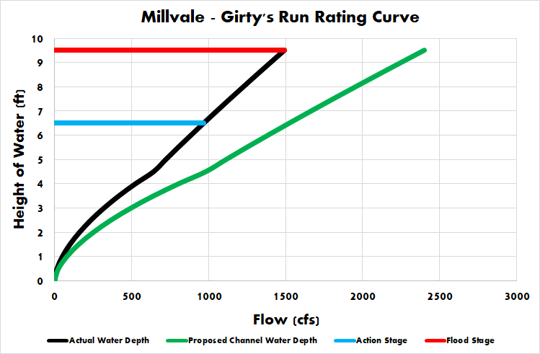
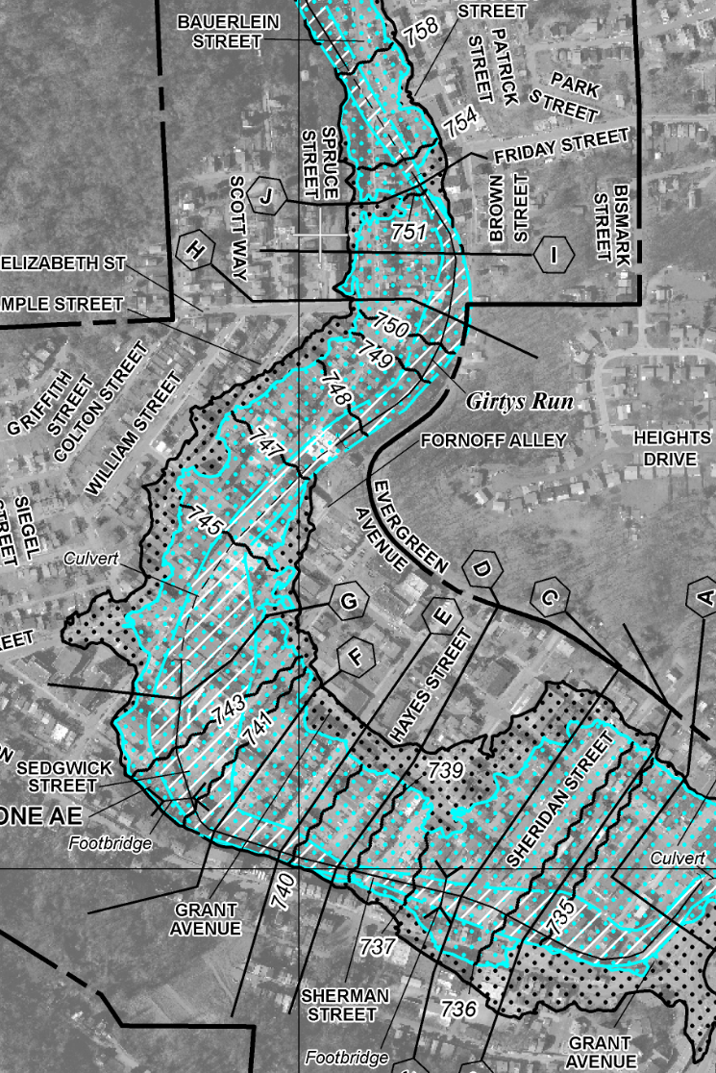
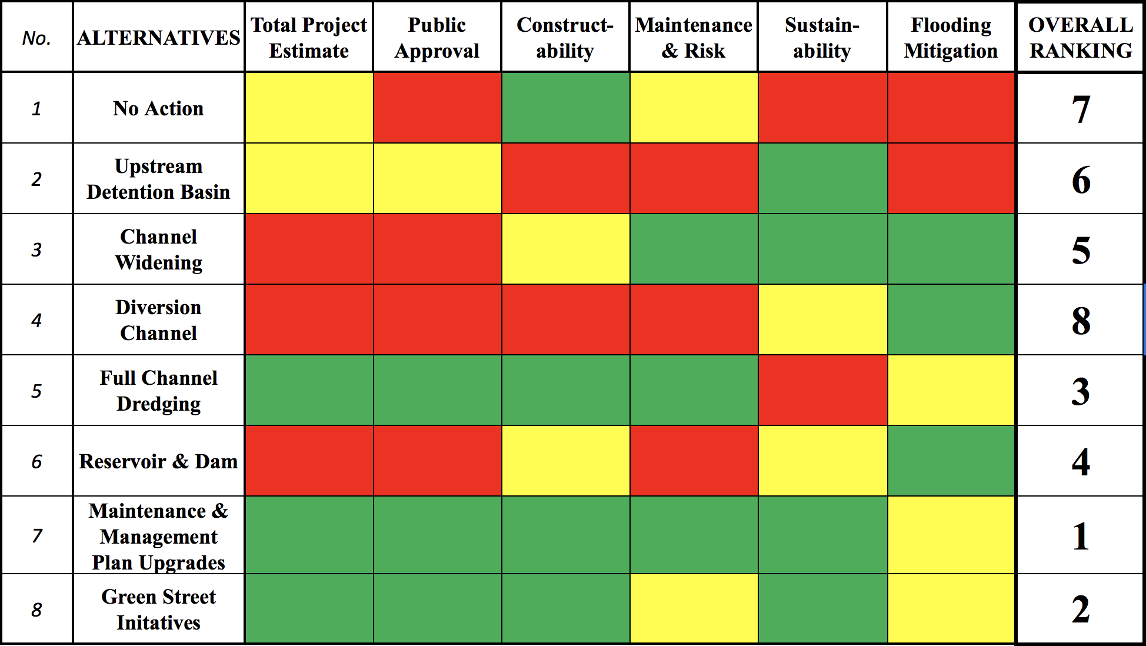
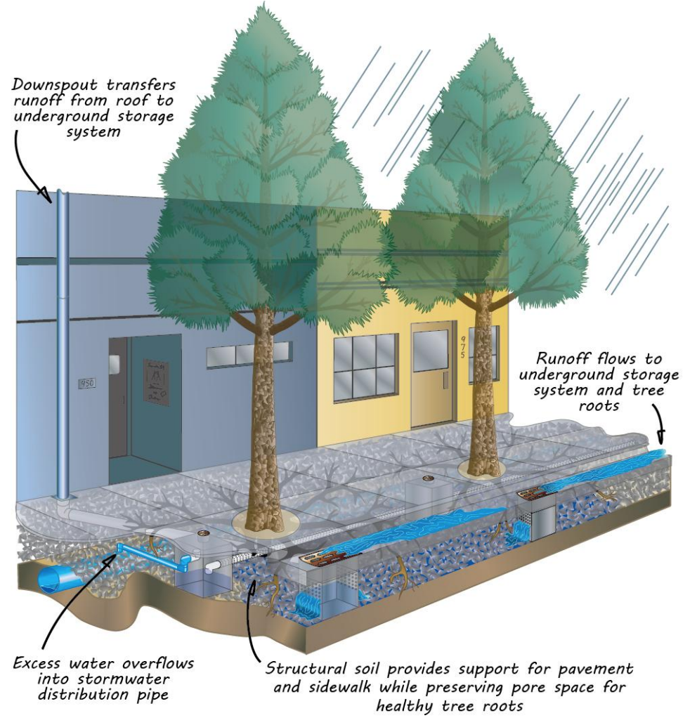
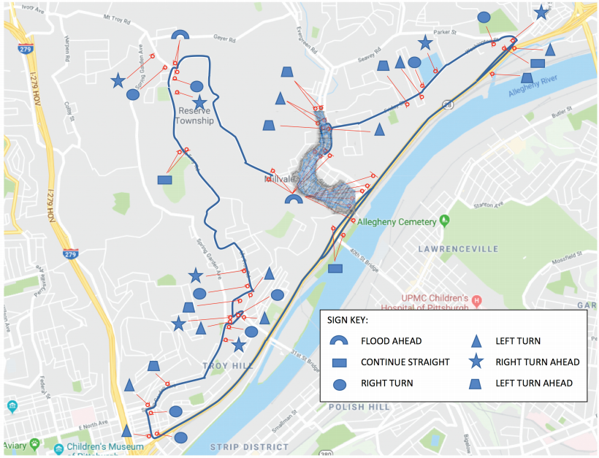
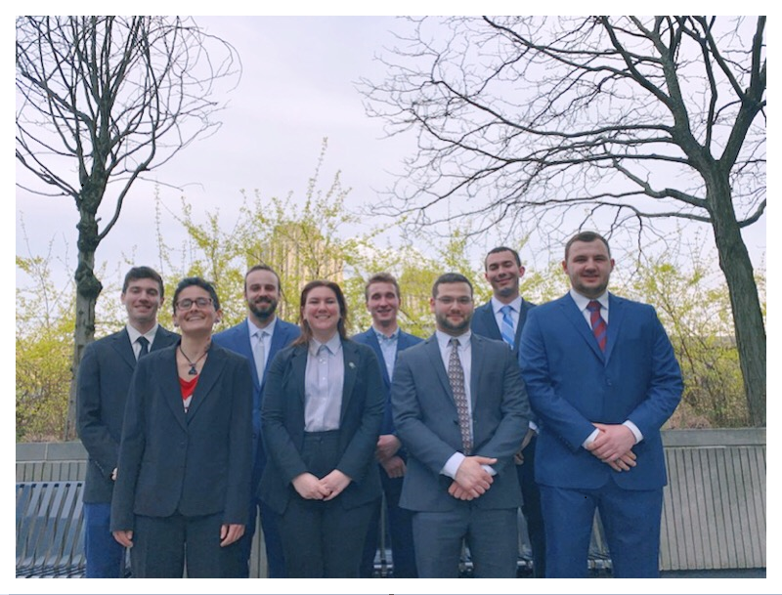
Girty's Run Flood Control Alternatives Analysis
ALTERNATIVES
Introduction & Millvale's History
1. No Action
5. Full Channel Dredging
Watershed Overview & Figures
The borough of Millvale rests at the bottom of a valley, with the stream of Girty's Run flowing through the center of the town, finally meeting the Allegheny River. While the Girty's Run watershed includes upstream communities such as Ross and Shaler townships, Millvale's location predisposes the borough to heavy flooding, affecting the borough's environmental, social, and economic sustainability. Historical flooding in Millvale has prompted multiple initiatives to decrease flooding over the years. Severe flooding in the past 90 years prompted various flood control projects along Girty's Run in Millvale.
Today there are still high concerns of flooding, our team conducted an alternatives analysis looking into possible solutions for flood mitigation. Considering six criteria including total project estimate, public approval, constructability, maintenance and risk, sustainability and flood mitigation we proposed eight possible alternatives to do an analysis.
The no action alternative consists of the cost, damages and cleanup of Millvale if nothing were to be done for flood mitigation. The average annual damages to Millvale due to flooding is $1.94 million. This alternative does nothing to mitigate the flooding and therefore ranks 7th on the list.
Full channel dredging is an alternative that would increase the capacity significantly. If all 45,000 cubic feet of silt is removed, then the channel will effectively be 2.5 feet deeper, allowing for Girty's Run to handle more rainfall. Mechanical dredging of the entire channel would cost $150,000. It has historically been completed and led to improvement. For these reasons, it ranks third on our list.
2. Upstream Detention Basin
6. Reservoir & Dam
A possible alternative that was considered was
the use of upstream detention basins in the watershed. Out of the two designs that were considered, to achieve a significant reduction in peak flow, the area required for the pond was not feasible. Additionally, due to Millvale's proneness to high intensity isolated storms and due to unsuitable locations and size of basin, this alternative ranked 6th on the list.
While researching a Reservoir/Dam structure we discovered the Army Corps Of Engineers had a full design and proposal of a dam for the Girty's Run watershed located on Evergreen road at Babcock Blvd. The design of the dam would effectively mitigate the flooding that Millvale experiences, however there were some issues with the proposal. The public was heavily opposed to this design because businesses and homes would have to be bought out. Another issue is the design would require the closure and relocation of a heavily travelled roadway. This alternative ranked 4th on the list.
Project Summary
Our group performed an alternatives analysis on various potential projects that would help mitigate flooding in downtown Millvale, and from these alternatives, chose the most feasible ones. To provide context, a watershed study was also compiled, showing the current state of the watershed, as well as showing how some of our alternatives would help improve the channel. Finally, our group evaluated the alternatives using the listed criteria and rated them from best to worst . Our recommendations will be provided to Girty's Run Watershed Association.
3. Channel Widening
Summary
7. Maintenance & Management Upgrades
A preliminary design of the channel widening alternative was proposed to increase the channel width by a total of 9 ft in order to carry the flows caused by the moderate flood stage of 2400 cfs. Depicted in the rating curve for the original channel as well as the widened channel. Due to poor public approval and high construction costs this alternative ranked 5th on the list.
This alternative consists of three parts: Comprehensive watershed survey, emergency management plan and annual maintenance plan. The survey would allow for a better understanding of how the watershed functions. The emergency management plan would consist of a siren alert system linked to staff gauges as well as a flood detour route. The annual maintenance plan consists of yearly inspections, channel structure repairs and localized dredging. This option is most feasible to implement in the short term and therefore ranks 1st.
4. Diversion Channel
Two designs for a diversion channel were considered for the project. First a preliminary open channel design was considered but was quickly found to be unreasonable due to the amount of major excavation required to reach the existing channel. A box culvert was considered but was dismissed for similar reasons including the need for major excavation. Due to the difficulty and cost this option ranks 8th.
8. Green Streets Initiatives
Team RRDA (Left to Right)
Liam Gillen-Hughes (Geotech)
Angela Urban (Transportation)
Luke Piotrowicz (Water Resources)
Kaylie Jones (Environmental)
Benjamin Grunauer (Water Resources)
Dylan Margolis (Construction Management)
Robert Cornwall (Transportation)
Nickolas Panchik (Construction Management)
The Green Streets initiative uses a combination of green stormwater infrastructure and improved sidewalk drainage to mitigate runoff, promote infiltration, and decrease localized flooding. Our plan includes sidewalk drains, underground runoff storage and street trees. This option ranks high in sustainability while moderately reduces flooding and ranks 2nd on the list.
We would like to thank Werner Loehlein, John Sebastian, John Darnley, Sara Woida, Patricia Kitchen, Donna Pearson, Alexis Boytim, & Zaheen Hussain.

